Slide 1
Lecture 1: Introduction to Regression HUB AI

Slide 2
Lecture Outline
Logistics
Class Structure
Data
Statistical Modeling I
k-Nearest Neighbors (kNN)
Model Fitness
How does the model perform predicting?
Comparison of Two Models
How do we choose from two different models?

Slide 3
Class Logistics

Slide 4
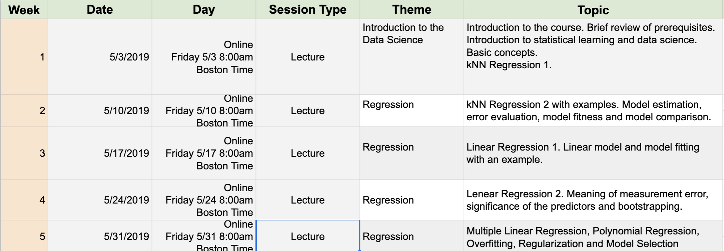
What
Online

Slide 5
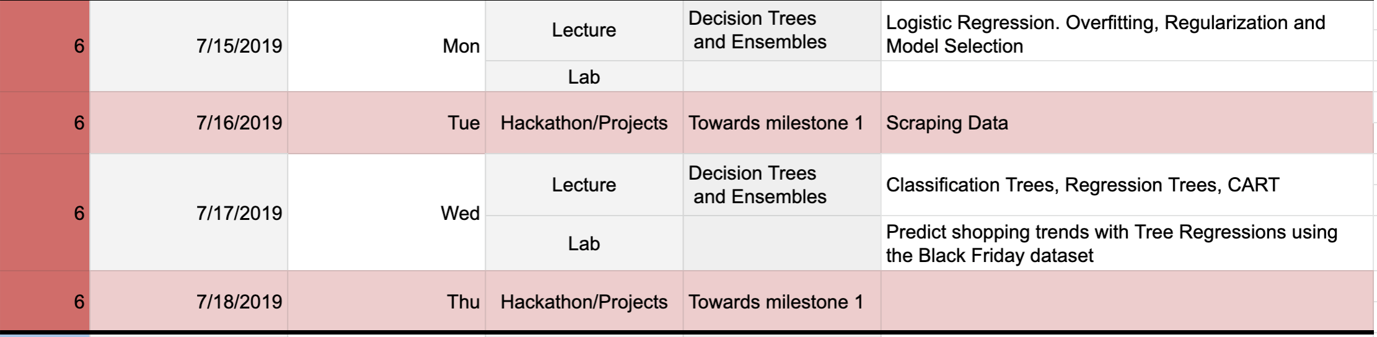
What
Offline, aka China
Week 1

Slide 6
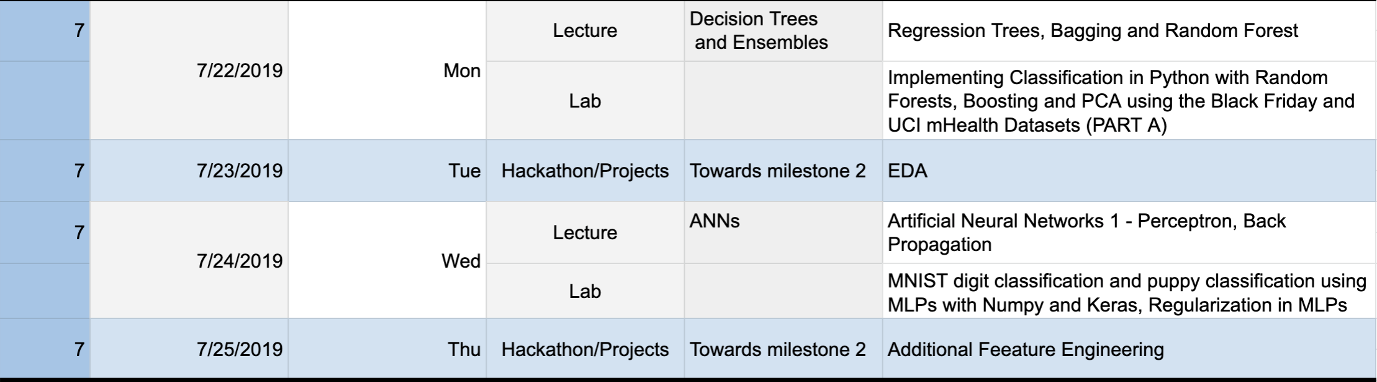
What
Offline, aka China
Week 2

Slide 7
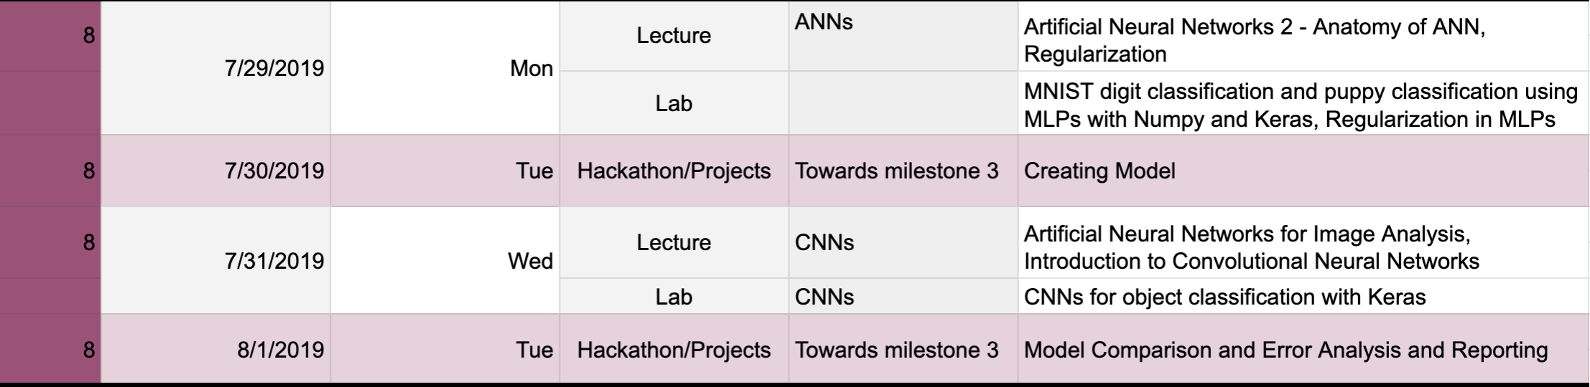
What
Offline, aka China
Week 3

Slide 8

Who
Pavlos Protopapas, Scientific Director of the Institute for Applied Computational Science (IACS). Teaches CS109a, CS109b and the Capstone course for the Data Science masters program. He has taught in GEC 3 courses already. His research is in astrostatistics and excited about the new telescopes coming online in the next few years.

Slide 9

Who: Teaching Fellow
Patrick Ohiomoba has a wealth of experience as teaching fellows for Data Science and Machine Learning courses at Harvard’s School of Engineering and Applied Sciences. He is from Nigeria and he likes among other things eating good food, following sports (football) and keeping up with the latest ML and AI developments.

Slide 10
How
Lectures:
Fridays @8am [EST] (except today)
Labs:
Saturdays @8am [EST] Patrick Ohiomoba
Meeting ID: 943 758 711
https://zoom.us/j/943758711

Slide 11
How: Project
Predicting Municipal Rental Prices
At some point in time, each of us would have went through the process of either renting or buying a house.
The renting of residential properties is an economic process that serves a really important role in many communities (especially urban communities) in the United States. First of all residential leasing is one of the key pathways for property owners and landlords to realize value from their property. In many cases (especially in communities where multi-family homes are common) renting is an essential part of the financial calculus that allows certain classes of people to fulfill their dreams of home/property ownership. A second factor is that residential rentals are an essential mechanism for people to live in a community without the often onerous burdens of purchasing properties outright. In fact for a number of the most iconic neighborhoods in the urban United States the essential character of the neighborhood (as well as the properties) would change drastically (in most cases for the worse) if residential renting was abolished.

Slide 12
Data Science

Slide 13

Why?

Slide 14
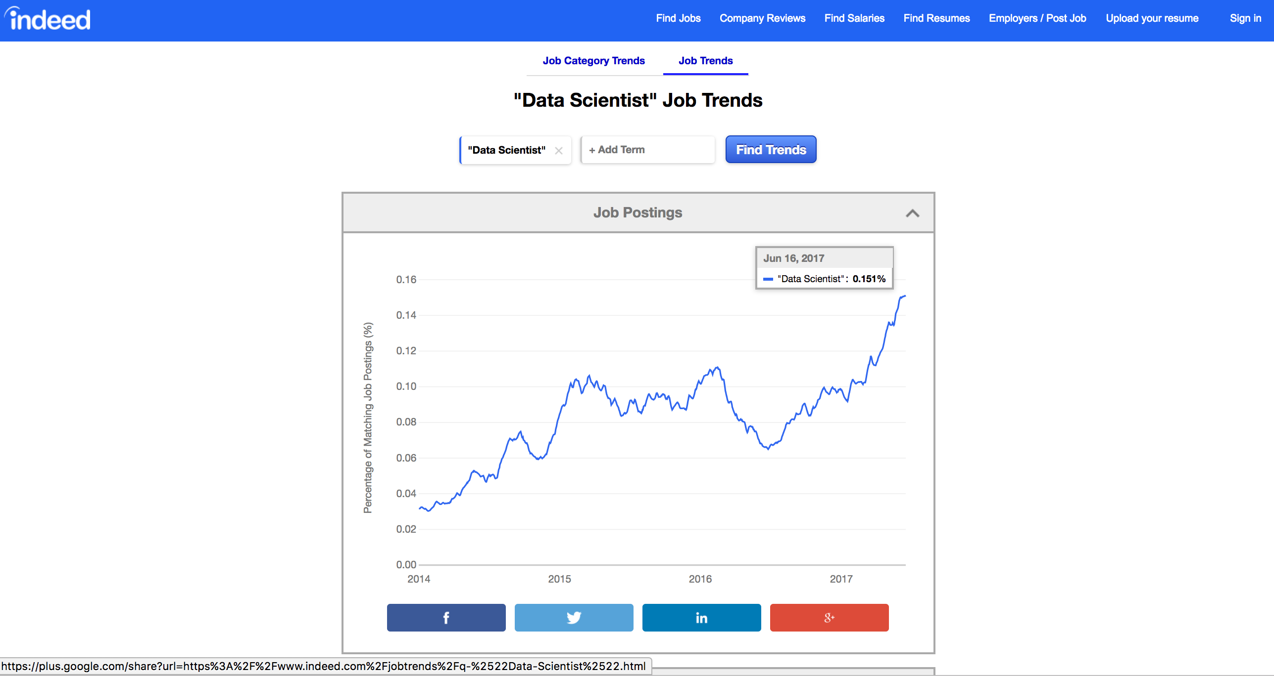
Why?

Slide 15
Why?

Slide 16
Data Science Process

Slide 17
Let’s start

Slide 18
Predicting a Variable
Let's image a scenario where we'd like to predict one variable using another (or a set of other) variables.
Examples:
Predicting the amount of view a YouTube video will get next week based on video length, the date it was posted, previous number of views, etc.
Predicting which movies a Netflix user will rate highly based on their previous movie ratings, demographic data etc.

Slide 19
Data

Slide 20

What are Data?
“A datum is a single measurement of something on a scale that is understandable to both the recorder and the reader. Data are multiple such measurements.” Claim: everything is (can be) data!

Slide 21
Where do data come from?
• Internal sources: already collected by or is part of the overall data collection of you organization. For example: business-centric data that is available in the organization data base to record day to day operations; scientific or experimental data
• Existing External Sources: available in ready to read format from an outside source for free or for a fee. For example: public government databases, stock market data, Yelp reviews, [your favorite sport]-reference
• External Sources Requiring Collection Efforts: available from external source but acquisition requires special processing. For example: data appearing only in print form, or data on websites

Slide 22
Ways to gather online data
How to get data generated, published or hosted online:
• API (Application Programming Interface): using a prebuilt set of functions developed by a company to access their services. Often pay to use. For example: Google Map API, Facebook API, Twitter API
• RSS (Rich Site Summary): summarizes frequently updated online content in standard format. Free to read if the site has one. For example: news-related sites, blogs
• Web scraping: using software, scripts or by-hand extracting data from what is displayed on a page or what is contained in the HTML file.

Slide 23
Web scraping
• Why do it? Older government or smaller news sites might not have APIs for accessing data, or publish RSS feeds or have databases for download. Or, you don’t want to pay to use the API or the database.
• How do you do it? See lab session.
• Should you do it?
– You just want to explore: Are you violating their terms of service? Privacy concerns for website and their clients?
– You want to publish your analysis or product: Do they have an API or fee that you are bypassing? Are they willing to share this data? Are you violating their terms of service? Are there privacy concerns?

Slide 24
Types of data
What kind of values are in your data (data types)?
Simple or atomic:
• Numeric: integers, floats
• Boolean: binary or true false values
• Strings: sequence of symbols

Slide 25
Data Types
What kind of values are in your data (data types)? Compound, composed of a bunch of atomic types:
• Date and time: compound value with a specific structure
• Lists: a list is a sequence of values
• Dictionaries: A dictionary is a collection of key-value pairs, a pair of values x : y where x is usually a string called the key representing the “name” of the entry, and y is a value of any type.
Example: Student record: what are x and y?
• First: Pavlos
• Last: Ohiomoba
• Classes: [CS-109A]

Slide 26
Data storage
How is your data represented and stored (data format)?
• Tabular Data: a dataset that is a two-dimensional table, where each row typically represents a single data record, and each column represents one type of measurement (csv, dat, xlsx, etc.).
• Structured Data: each data record is presented in a form of a [possibly complex and multi-tiered] dictionary (json, xml, etc.)
• Semistructured Data: not all records are represented by the same set of keys or some data records are not represented using the key-value pair structure.

Slide 27
Data format
How is your data represented and stored (data format)?
• Textual Data
• Temporal Data
• Geolocation Data

Slide 28
Tabular Data
In tabular data, we expect each record or observation to represent a set of measurements of a single object or event.
Each type of measurement is called a variable or an attribute or a predictor of the data (e.g. seq_id, status and duration are variables or attributes). The number of attributes is called the dimension. These are often called features.
We expect each table to contain a set of records or observations of the same kind of object or event (e.g. our table above contains observations of rides/checkouts).

Slide 29
Types of Data
We’ll see that it’s important to distinguish between classes of variables or attributes based on the type of values they can take on.
• Quantitative variable: is numerical and can be either:
• discrete - a finite number of values are possible in any bounded interval. For example: “Number of siblings” is a discrete variable
• continuous - an infinite number of values are possible in any bounded interval. For example: “Height” is a continuous variable
• Categorical variable: no inherent order among the values For example: “What kind of pet you have” is a categorical variable

Slide 30
Common Issues
Common issues with data:
• Missing values: how do we fill in?
• Wrong values: how can we detect and correct?
• Messy format
• Not usable: the data cannot answer the question posed

Slide 31
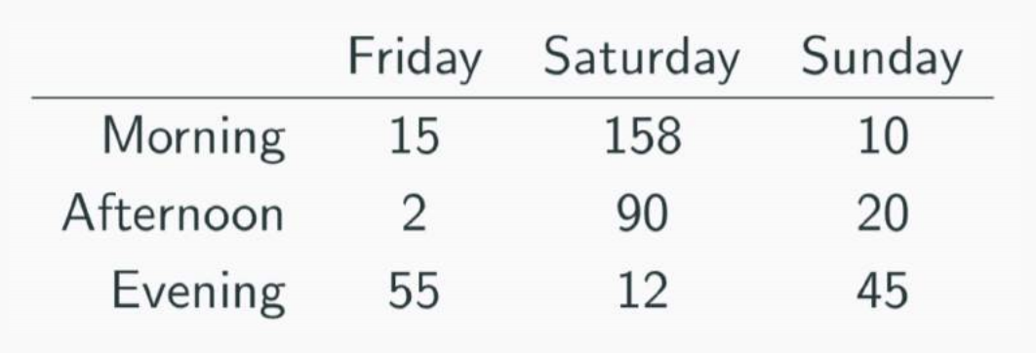
Messy Data
The following is a table accounting for the number of produce deliveries over a weekend.
What are the variables in this dataset? What object or event are we measuring?
What’s the issue? How do we fix it?

Slide 32
Messy Data
We’re measuring individual deliveries; the variables are Time, Day, Number of Produce.
Problem: each column header represents a single value rather than a variable. Row headers are “hiding” the Day variable. The values of the variable, “Number of Produce”, is not recorded in a single column.

Slide 33
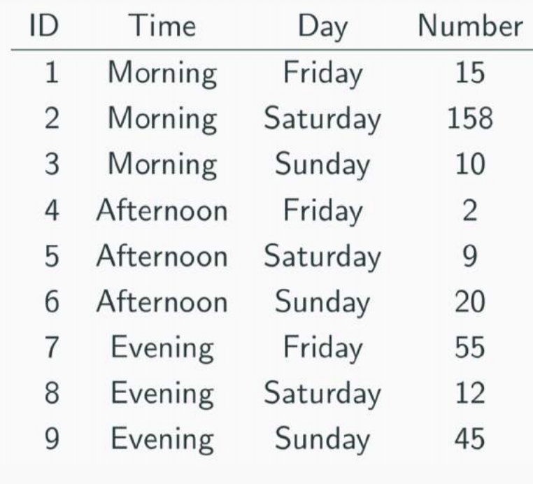
Fixing Messy Data
We need to reorganize the information to make explicit the event we’re observing and the variables associated to this event.

Slide 34
Tabular = Happy Pavlos ☺
Common causes of messiness are:
• Column headers are values, not variable names
• Variables are stored in both rows and columns
• Multiple variables are stored in one column/entry
• Multiple types of experimental units stored in same table
In general, we want each file to correspond to a dataset, each column to represent a single variable and each row to represent a single observation. We want to tabularize the data.
This makes Python happy.

Slide 35
Data Exploration: Descriptive Statistics

Slide 36
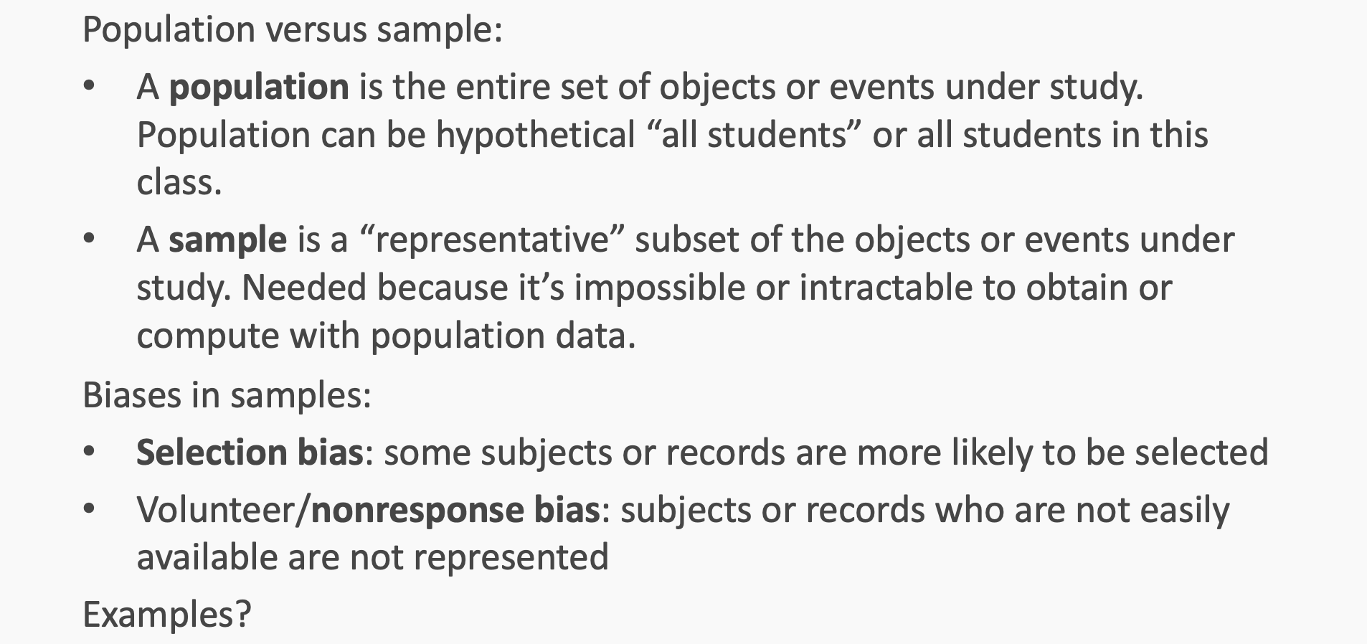
Basics of Sampling

Slide 37
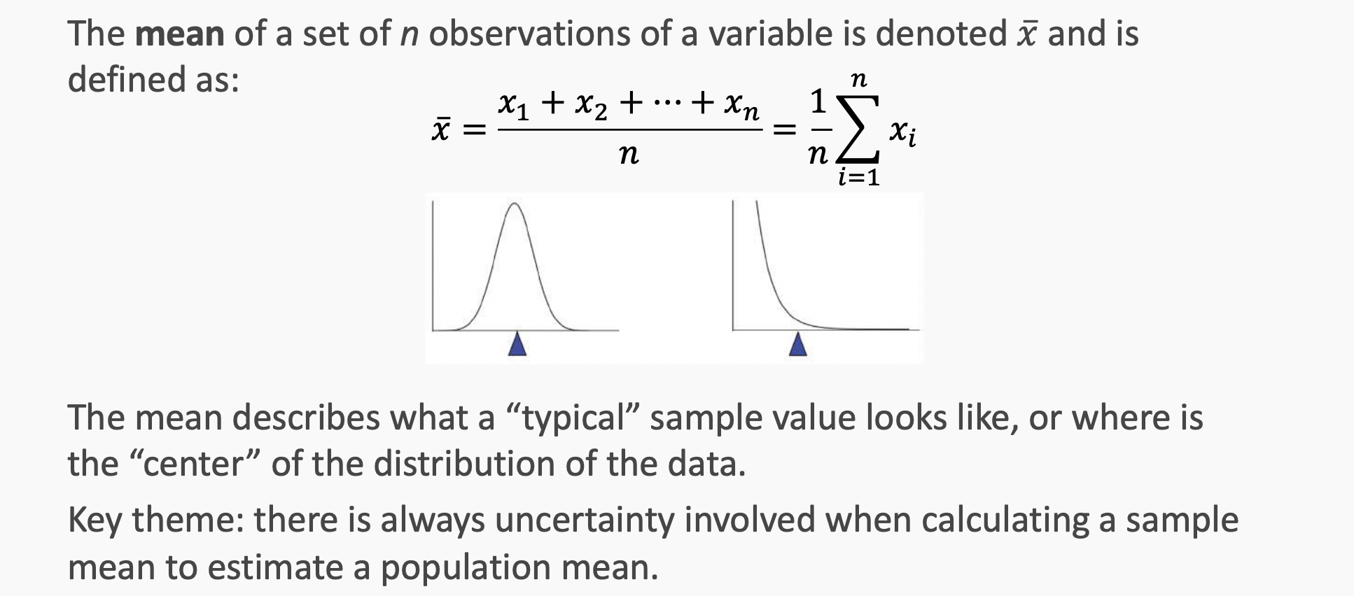
Sample mean

Slide 38
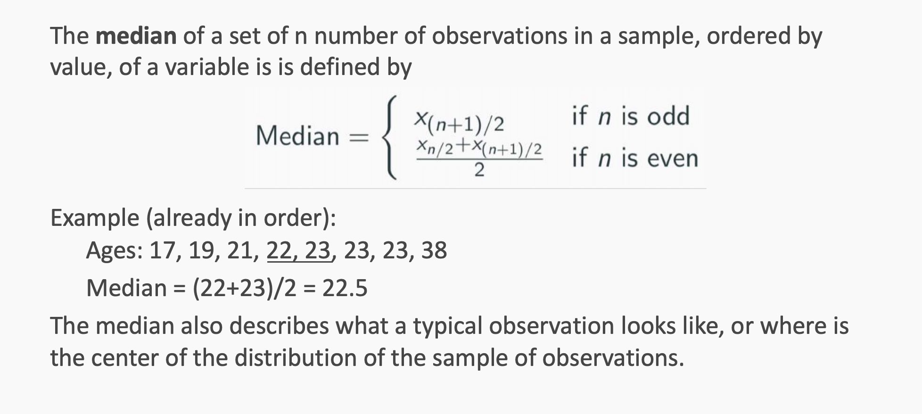
Sample median

Slide 39
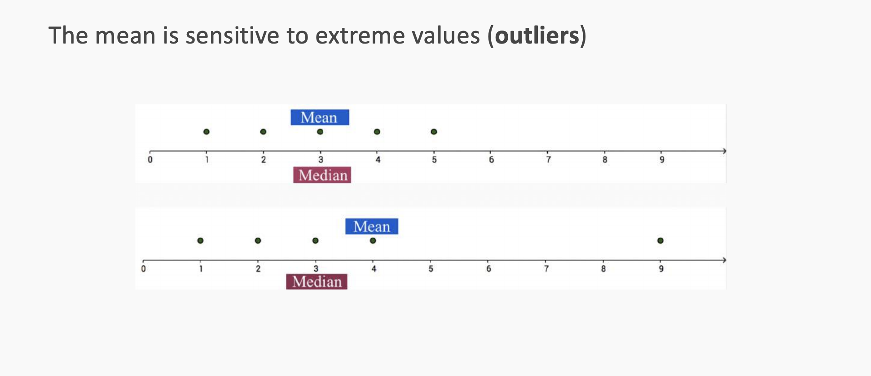
Mean vs. Median

Slide 40
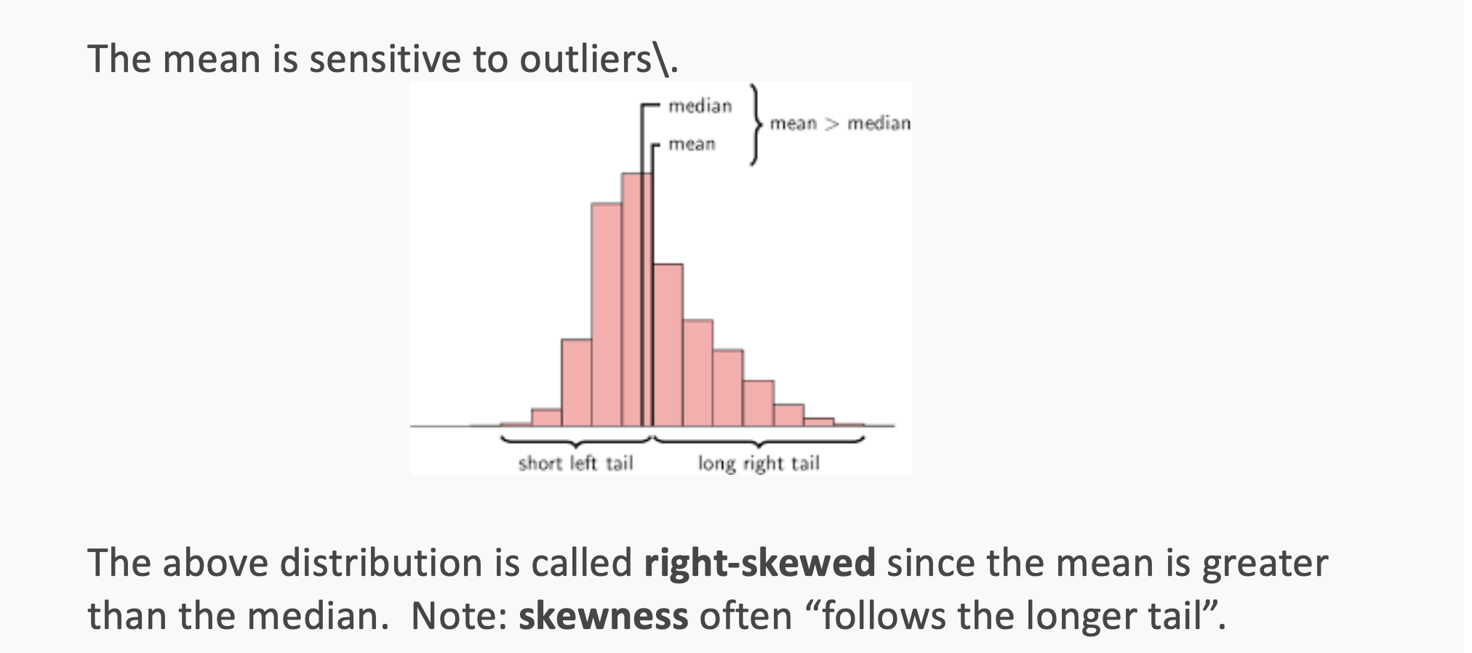
Mean, median, and skewness

Slide 41
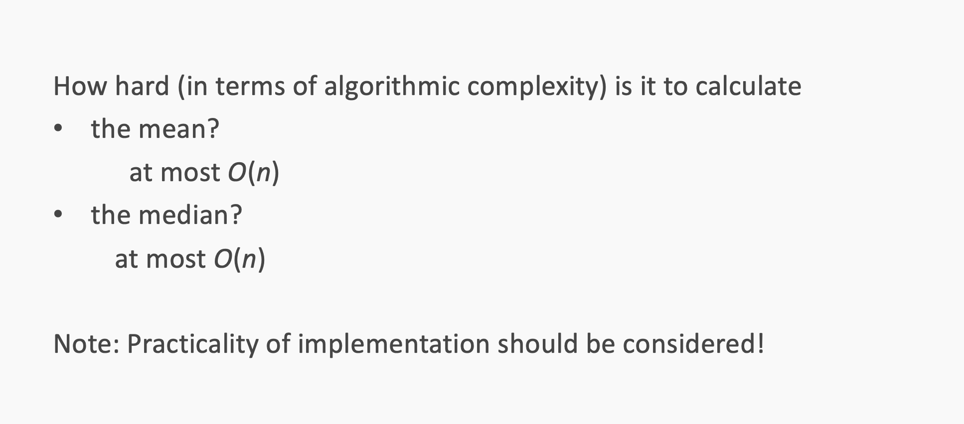
Computational time

Slide 42
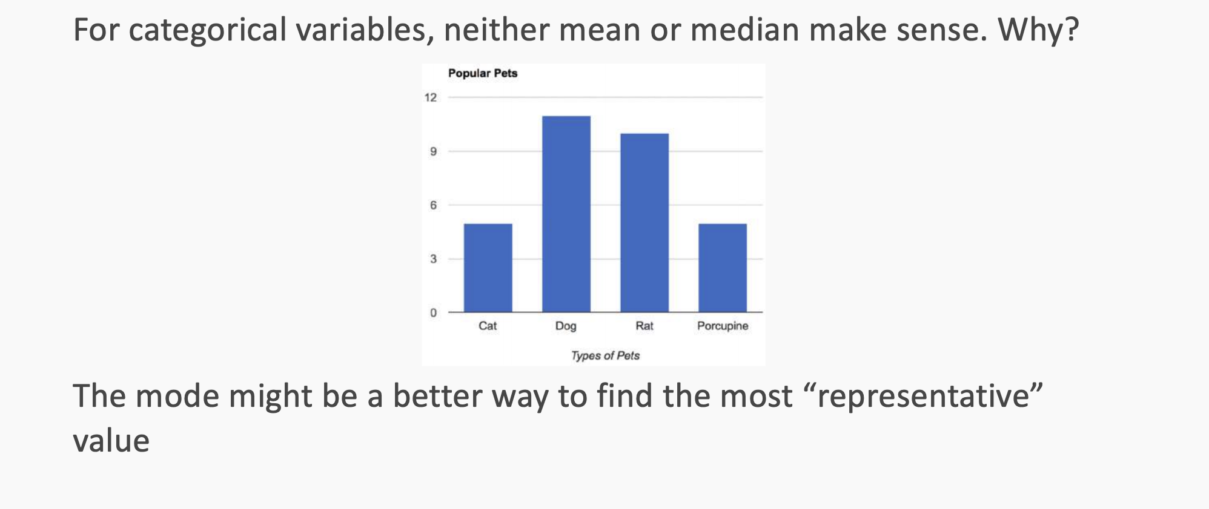
Regarding Categorical Variables...

Slide 43
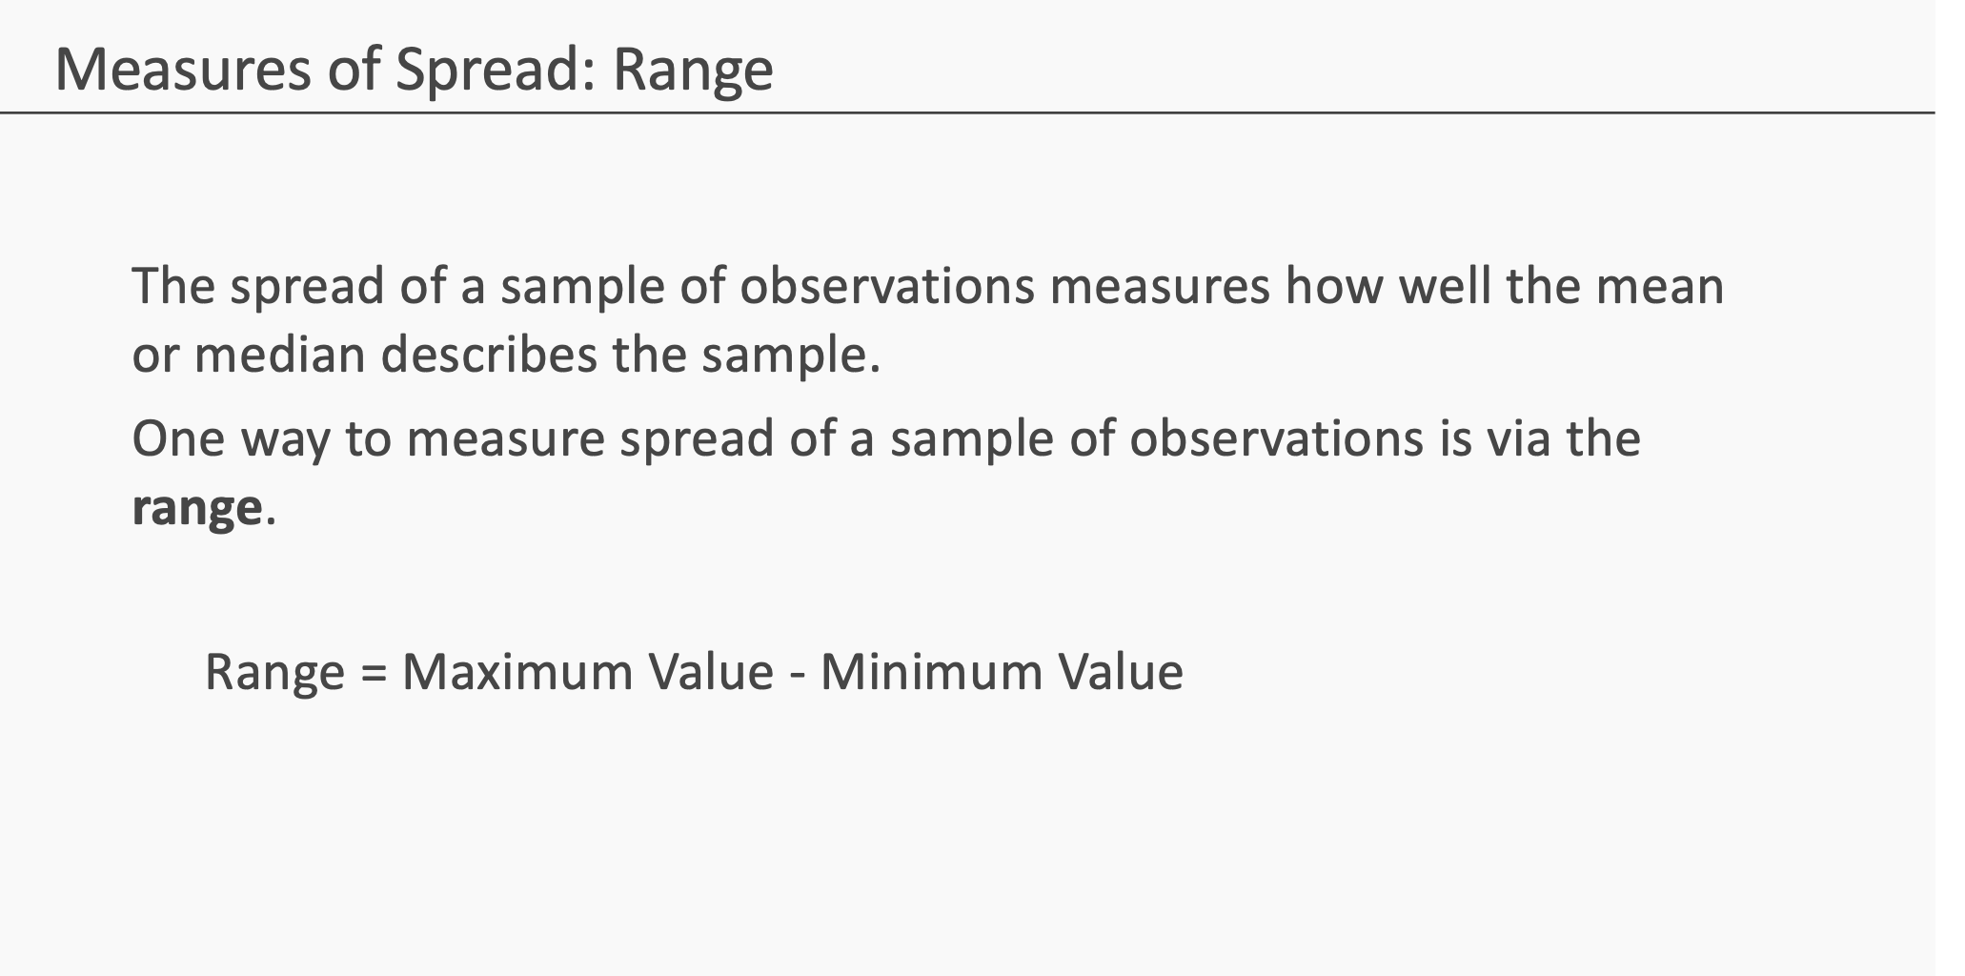

Slide 44
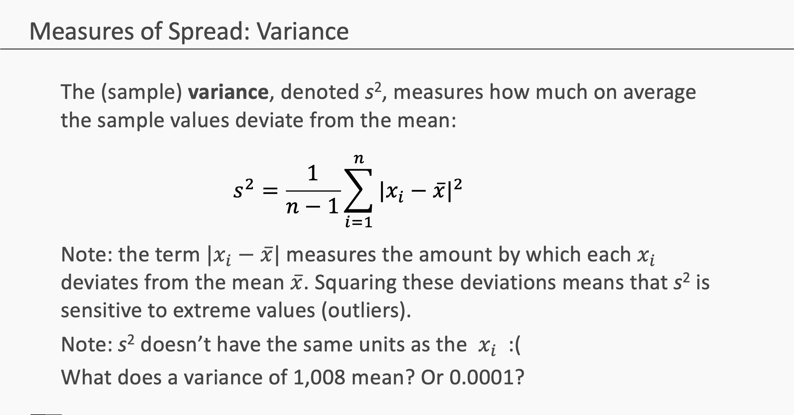

Slide 45
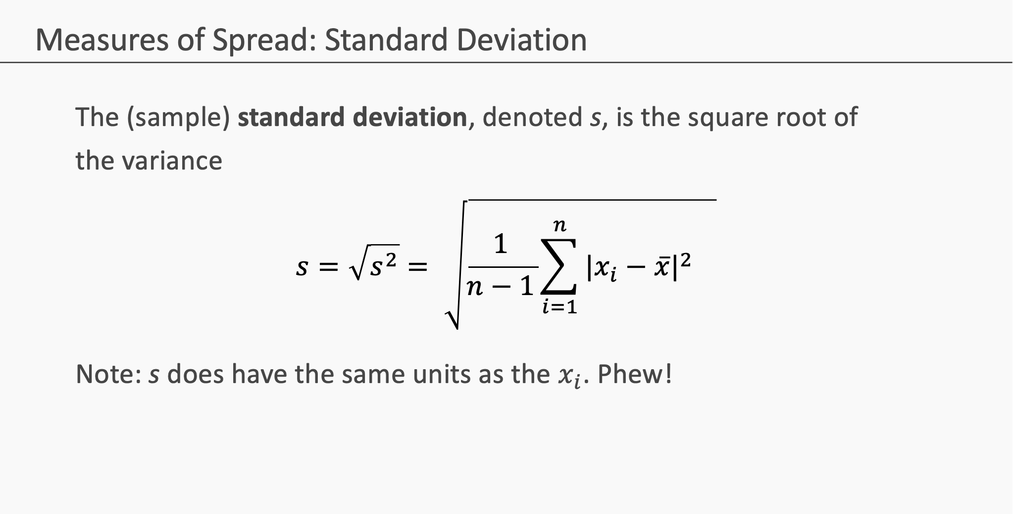

Slide 46
Modeling

Slide 47
Data
The Advertising data set consists of the sales of that product in 200 different markets, along with advertising budgets for the product in each of those markets for three different media: TV, radio, and newspaper. Everything is given in units of $1000.
,
TV | radio | newspaper | sales
230.1 | 37.8 | 69.2 | 22.1
44.5 | 39.3 | 45.1 | 10.4
17.2 | 45.9 | 69.3 | 9.3
151.5 | 41.3 | 58.5 | 18.5
180.8 | 10.8 | 58.4 | 12.9
Some of the figures in this presentation are taken from "An Introduction to Statistical Learning, with applications in R" (Springer, 2013) with permission from the authors: G. James, D. Witten, T. Hastie and R. Tibshirani "
Notes:
Supposed we were asked by a client to provide advice on how to improve sales of a particular product.
Does that footnote belong on this slide?

Slide 48
Response vs. Predictor Variables
There is an asymmetry in many of these problems:
The variable we'd like to predict may be more difficult to measure, is more important than the other(s), or may be directly or indirectly influenced by the values of the other variable(s).
Thus, we'd like to define two categories of variables:
variables whose value we want to predict
variables whose values we use to make our prediction.
Notes:
Give an example

Slide 49
Response vs. Predictor Variables
X
predictors
features
covariates
Y
outcome
response variable
dependent variable
TV | radio | newspaper | sales
230.1 | 37.8 | 69.2 | 22.1
44.5 | 39.3 | 45.1 | 10.4
17.2 | 45.9 | 69.3 | 9.3
151.5 | 41.3 | 58.5 | 18.5
180.8 | 10.8 | 58.4 | 12.9
n observations
p predictors

Slide 50
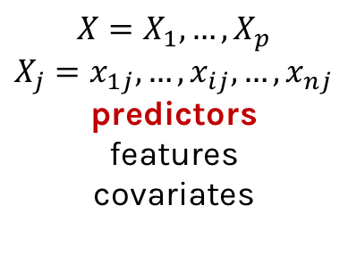
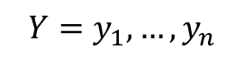
Response vs. Predictor Variables
$$X=X_{1},…,X_{p}$$
$$X_{j}=x_{1j},…,x_{ij},…,x_{nj}$$
predictors
features
covariates
outcome
response variable
dependent variable
$$Y=y_{1},…,y_{n}$$
TV | radio | newspaper | sales
230.1 | 37.8 | 69.2 | 22.1
44.5 | 39.3 | 45.1 | 10.4
17.2 | 45.9 | 69.3 | 9.3
151.5 | 41.3 | 58.5 | 18.5
180.8 | 10.8 | 58.4 | 12.9
n observations
p predictors
Notes:
I changed y_p to y_n. I think this makes the dimensions correct now. (DLS)

Slide 51
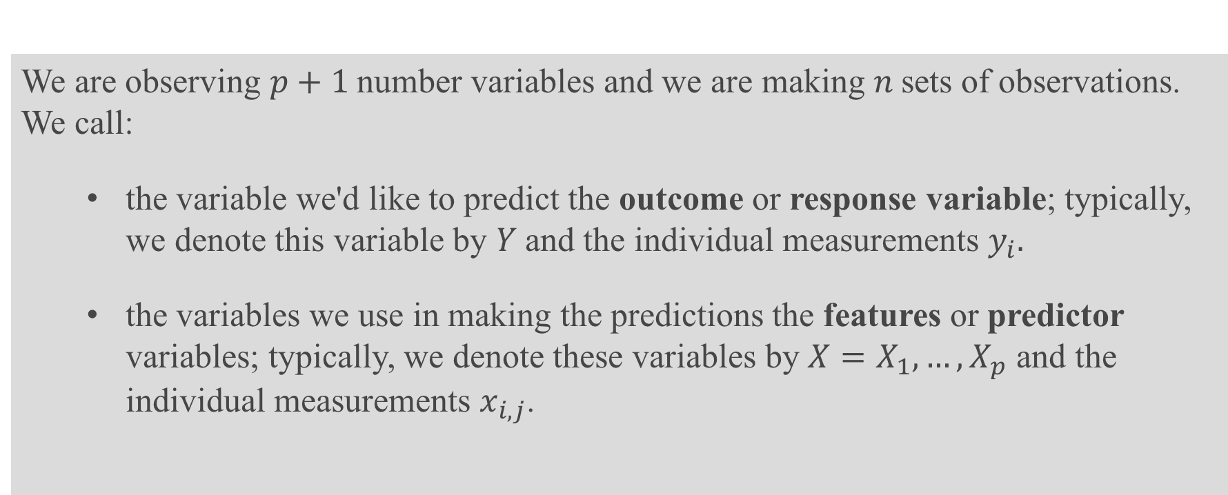
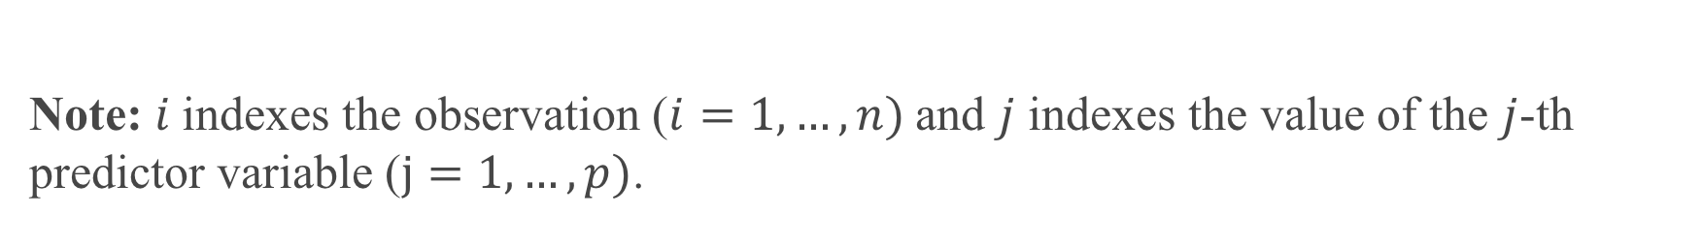
Definition
We are observing $p+1$number variables and we are making $n$sets of observations. We call:
the variable we'd like to predict the outcome or response variable; typically, we denote this variable by $Y$and the individual measurements $y_{i}.$
the variables we use in making the predictions the features or predictor variables; typically, we denote these variables by $X=X_{1},…,X_{p}$ and the individual measurements $x_{i,j}$.
Note: $i$indexes the observation ($i=1,…,n)$and $j$ indexes the value of the $j$-th predictor variable ($j=1,…,p)$.

Slide 52
Statistical Model

Slide 53
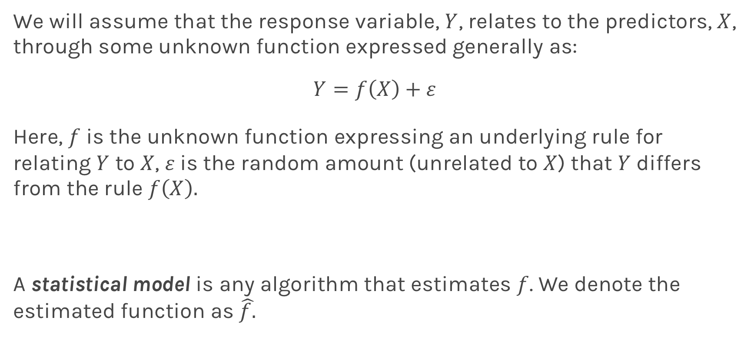
True vs. Statistical Model
We will assume that the response variable, $Y$, relates to the predictors, $X$, through some unknown function expressed generally as:
$$Y=f\left(X\right)+ε$$
Here, $f$ is the unknown function expressing an underlying rule for relating $Y$ to $X$, $ε$is the random amount (unrelated to $X$) that $Y$ differs from the rule $f\left(X\right).$
A statistical model is any algorithm that estimates $f$. We denote the estimated function as $\hat{f.}$
Notes:
Change x and y to uppercase? (DLS)

Slide 54
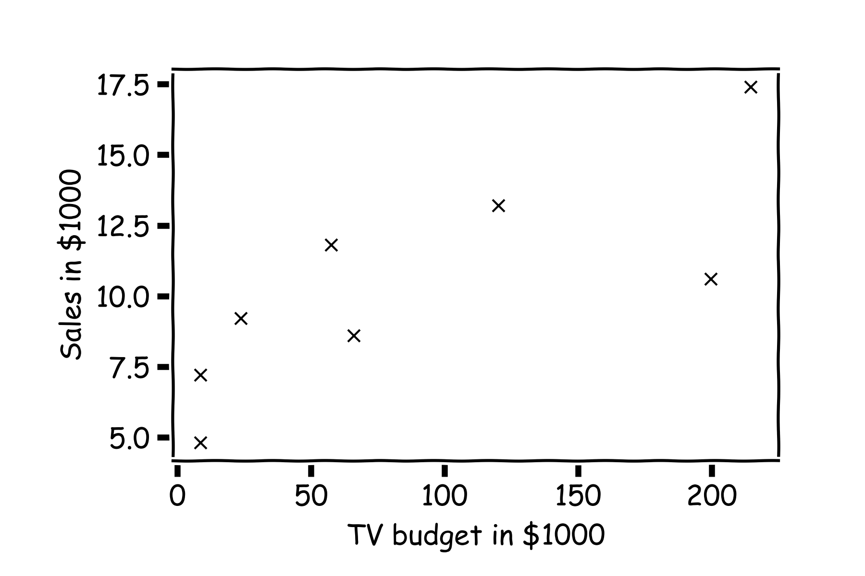
Statistical Model
y
x

Slide 55
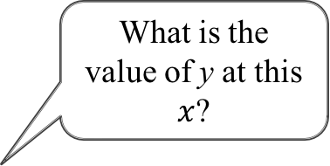
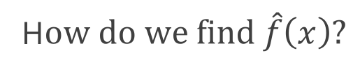
Statistical Model
H$ow do we find \hat{f}\left(x\right)?$
What is the value of y at this $x$?

Slide 56
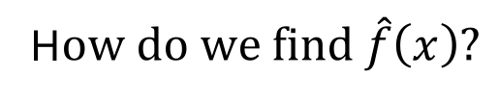
Statistical Model
H$ow do we find \hat{f}\left(x\right)?$
or here?

Slide 57
Statistical Model
Simple idea is to take the mean of all y’s, $\hat{f}\left(x\right)=\frac{1}{n}\sum_{1}^{n}{y_{i}}$

Slide 58
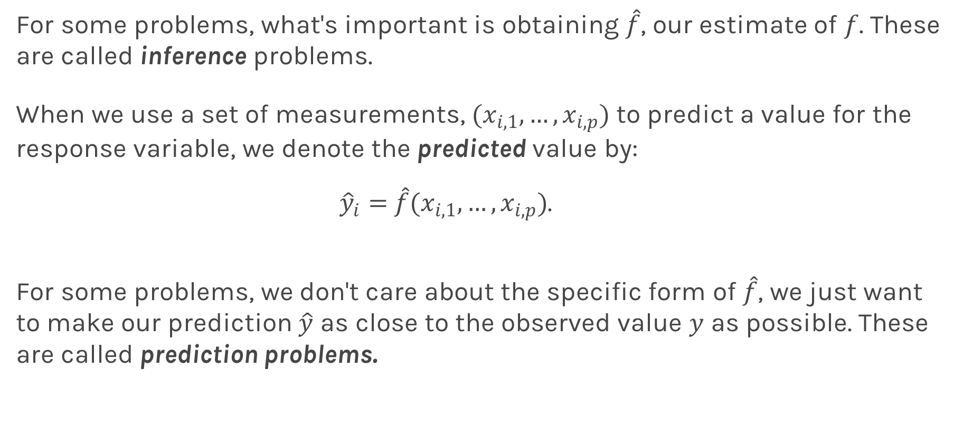
Prediction vs. Estimation
For some problems, what's important is obtaining $\hat{f}$, our estimate of $f$. These are called inference problems.
When we use a set of measurements, $(x_{i,1}, …,x_{i,p})$ to predict a value for the response variable, we denote the predicted value by:
${\hat{y}}_{i}=$ $\hat{f}(x_{i,1}, …,x_{i,p})$.
For some problems, we don't care about the specific form of $\hat{f}$, we just want to make our prediction $\hat{y}$ as close to the observed value $y$ as possible. These are called prediction problems.

Slide 59
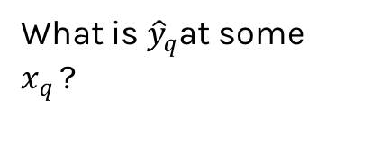
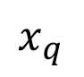
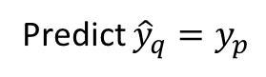
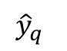
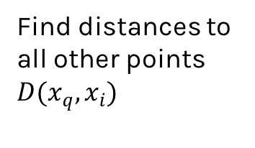
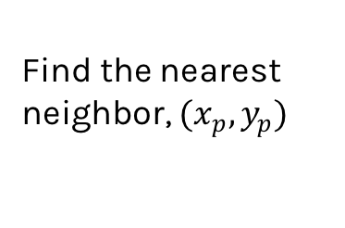
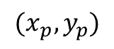
Simple Prediction Model
What is ${\hat{y}}_{q}$at some $x_{q }$?
Find distances to all other points $D(x_{q},x_{i})$
$${(x}_{p},y_{p})$$
$${\hat{y}}_{q}$$
Find the nearest neighbor, ${(x}_{p},y_{p})$
Predict ${\hat{y}}_{q}=y_{p}$
$$x_{q}$$
Notes:
Is it clear that x_q is really x_i,q? (DLS)

Slide 60
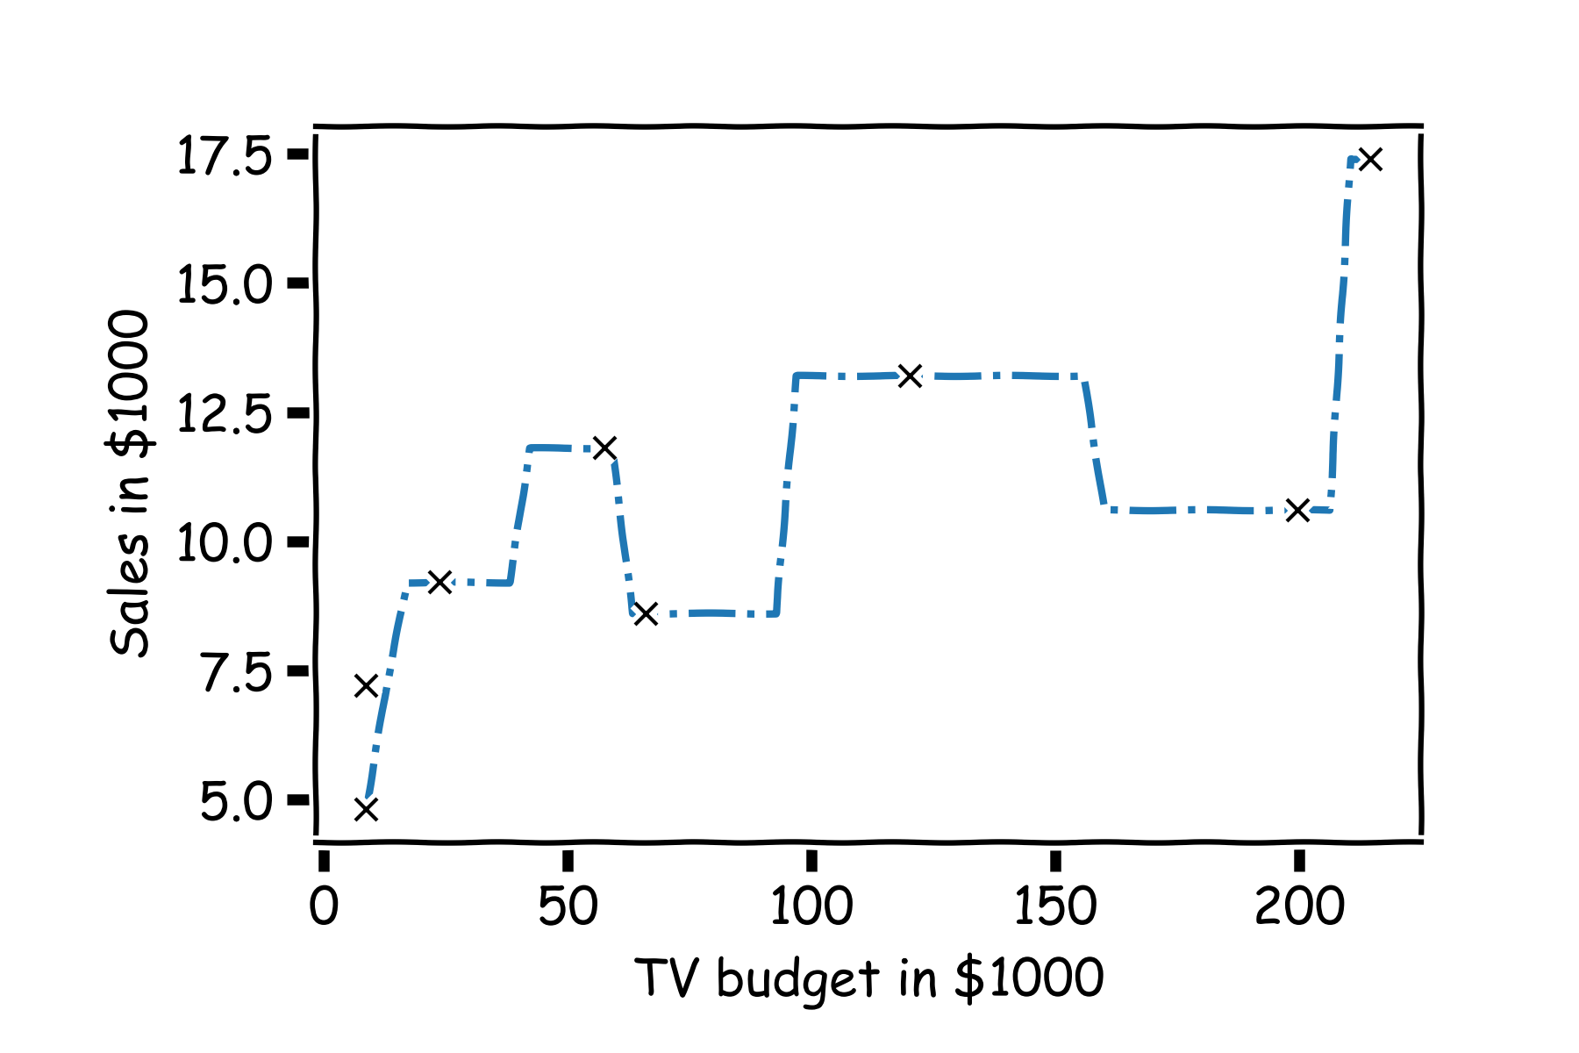
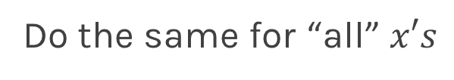
Simple Prediction Model
Do the same for “all” $x′s$

Slide 61
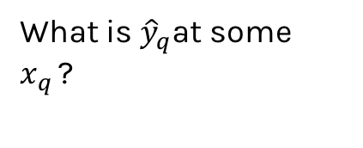
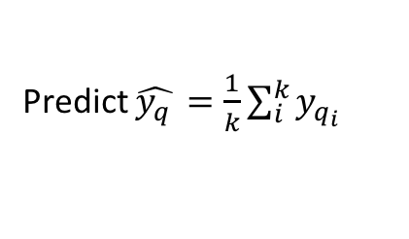
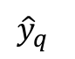
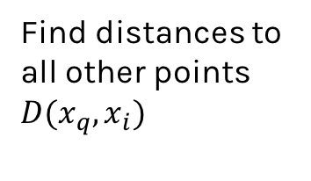
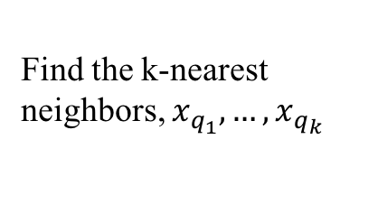
Extend the Prediction Model
What is ${\hat{y}}_{q}$at some $x_{q }$?
Find distances to all other points $D(x_{q},x_{i})$
$${\hat{y}}_{q}$$
Find the k-nearest neighbors, $x_{q_{1}},…,x_{q_{k}}$
Predict $\hat{y_{q }}=\frac{1}{k}\sum_{i}^{k}{y_{q_{i}}}$
$$x_{q}$$
Notes:
Change indeces and show k-nearest

Slide 62
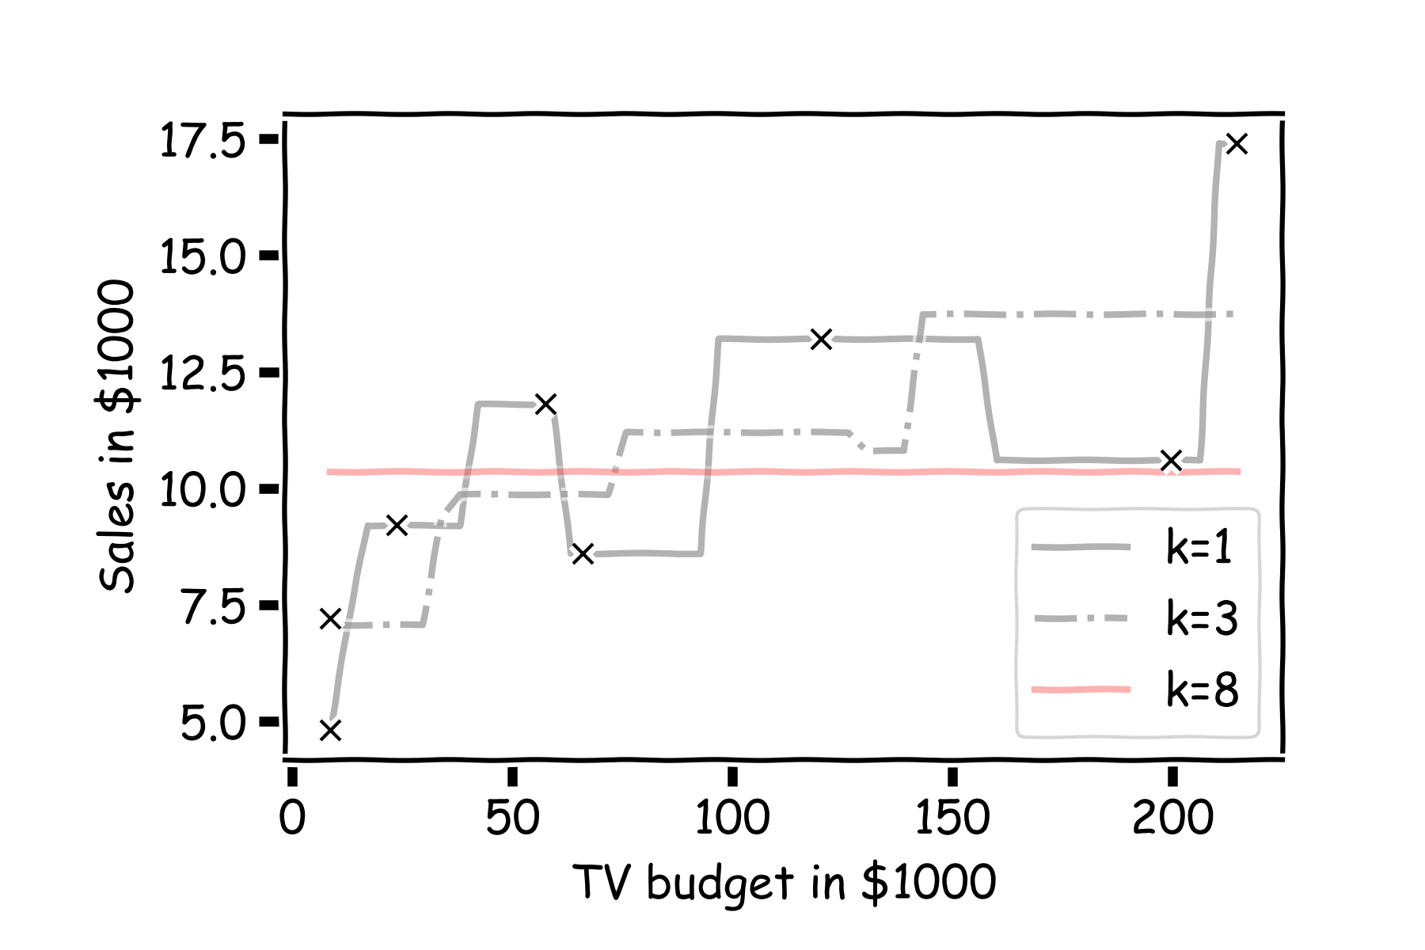
Simple Prediction Models
Notes:
Change indeces and show k-nearest

Slide 63

Simple Prediction Models
Same models on more data
Notes:
Change indeces and show k-nearest

Slide 64
k-Nearest Neighbors
The k-Nearest Neighbor (kNN) model is an intuitive way to predict a quantitative response variable:
to predict a response for a set of observed predictor values, we use the responses of other observations most similar to it
Note: this strategy can also be applied in classification to predict a categorical variable. We will encounter kNN again later in the course in the context of classification.
Notes:
Change indeces and show k-nearest

Slide 65
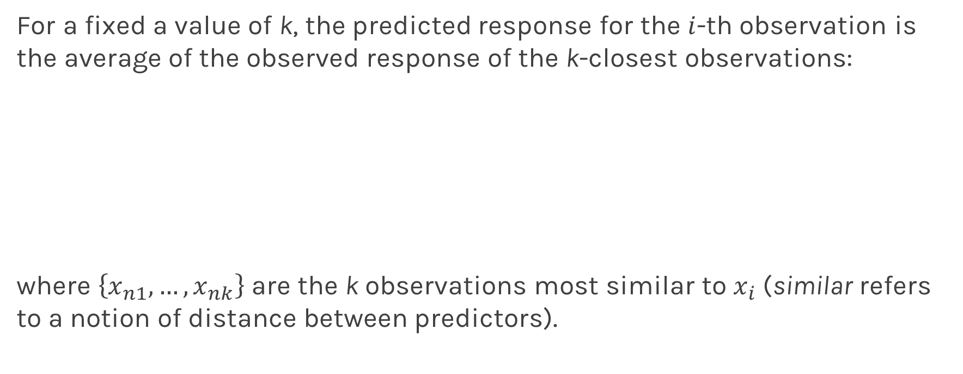
k-Nearest Neighbors - kNN
For a fixed a value of k, the predicted response for the $i$-th observation is the average of the observed response of the k-closest observations:
where $\left\{x_{n1},…,x_{nk}\right\}$ are the k observations most similar to $x_{i}$ (similar refers to a notion of distance between predictors).
Notes:
Notice y_hat instead of f_hat
I think the index on y_hat is wrong but I can’t change it b/c it’s an image. (DLS)

Slide 66
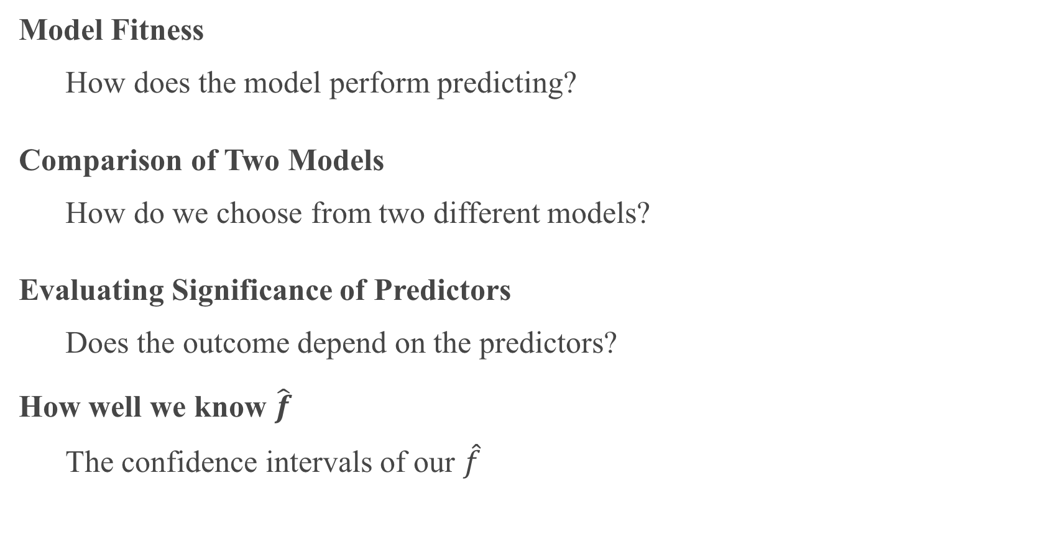
Things to Consider
Model Fitness
How does the model perform predicting?
Comparison of Two Models
How do we choose from two different models?
Evaluating Significance of Predictors
Does the outcome depend on the predictors?
How well we know $\hat{f}$
The confidence intervals of our $\hat{f}$

Slide 67
Error Evaluation

Slide 68
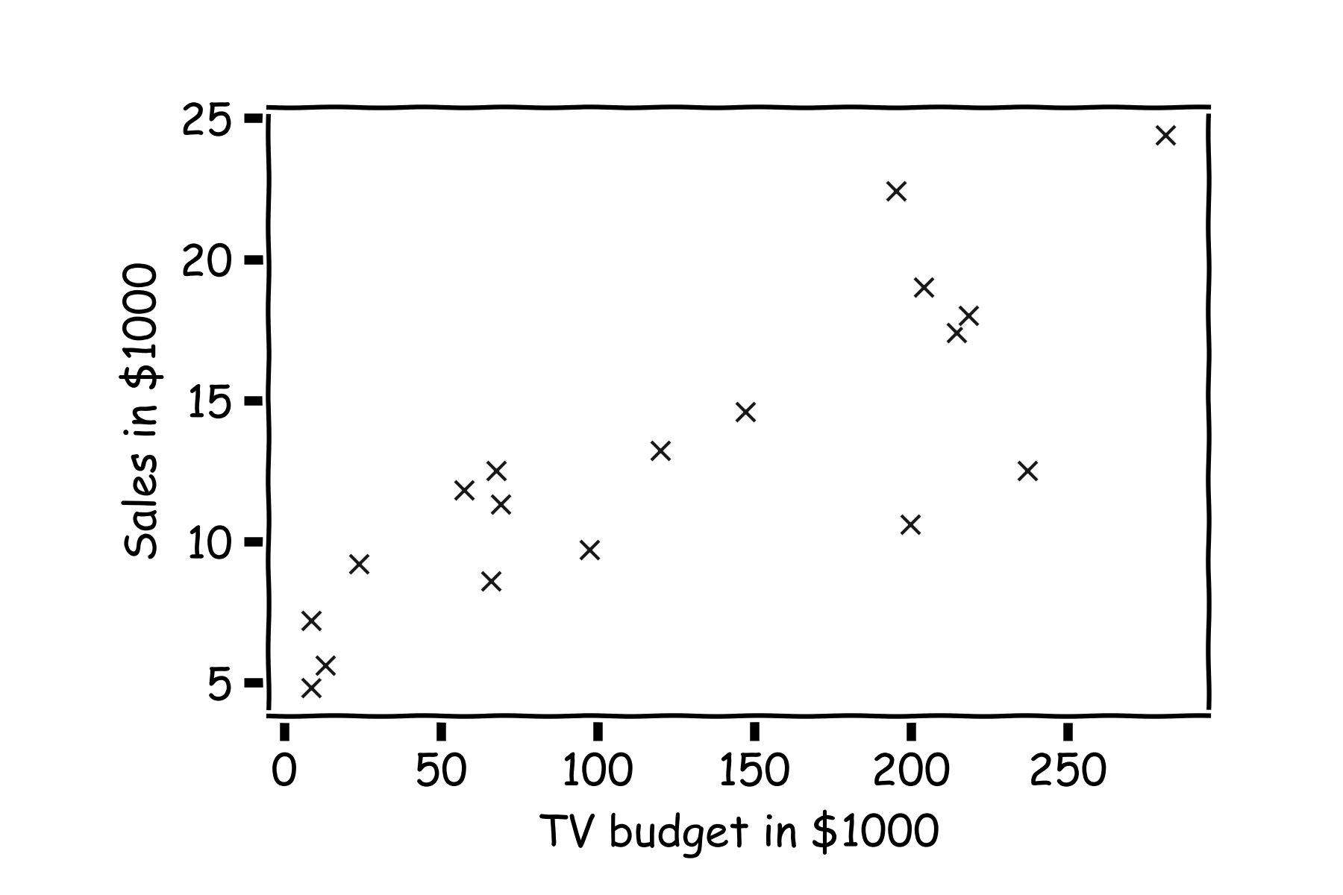
Error Evaluation
Start with some data.
Notes:
Change indeces and show k-nearest

Slide 69
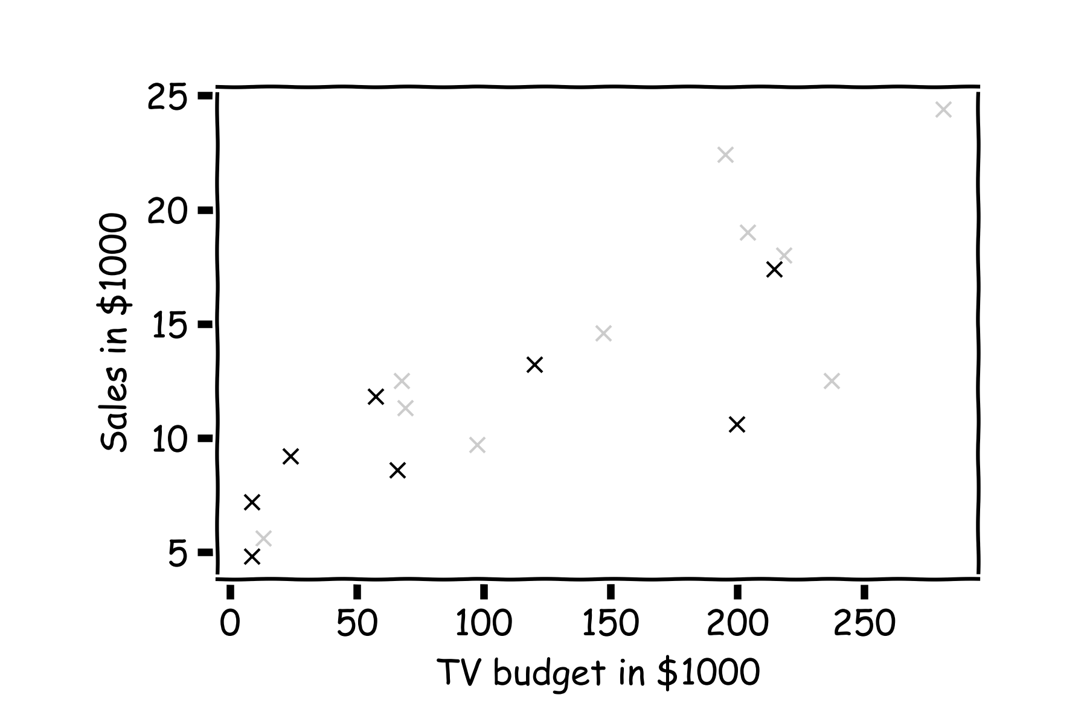
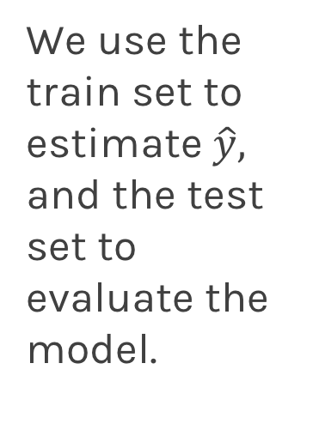
Error Evaluation
Hide some of the data from the model. This is called train-test split.
We use the train set to estimate $\hat{y},$ and the test set to evaluate the model.

Slide 70
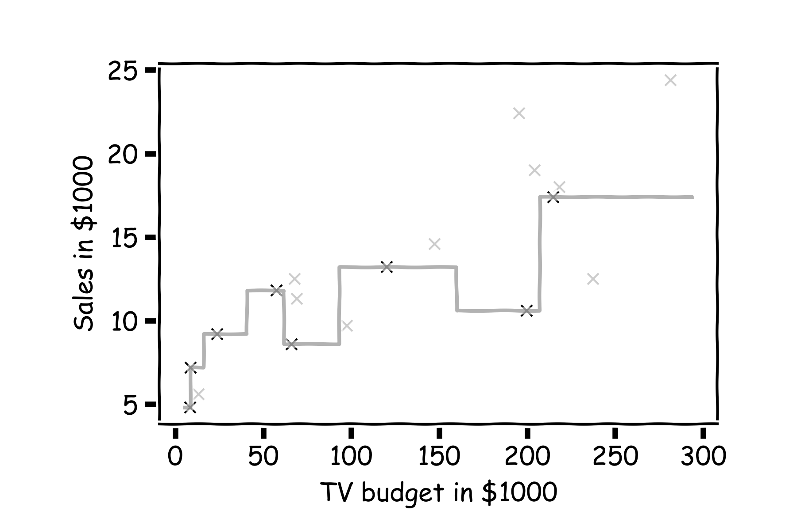
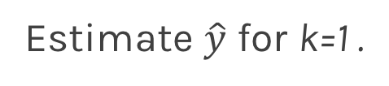
Error Evaluation
Estimate $\hat{y}$ for k=1 .
Notes:
Change indeces and show k-nearest

Slide 71
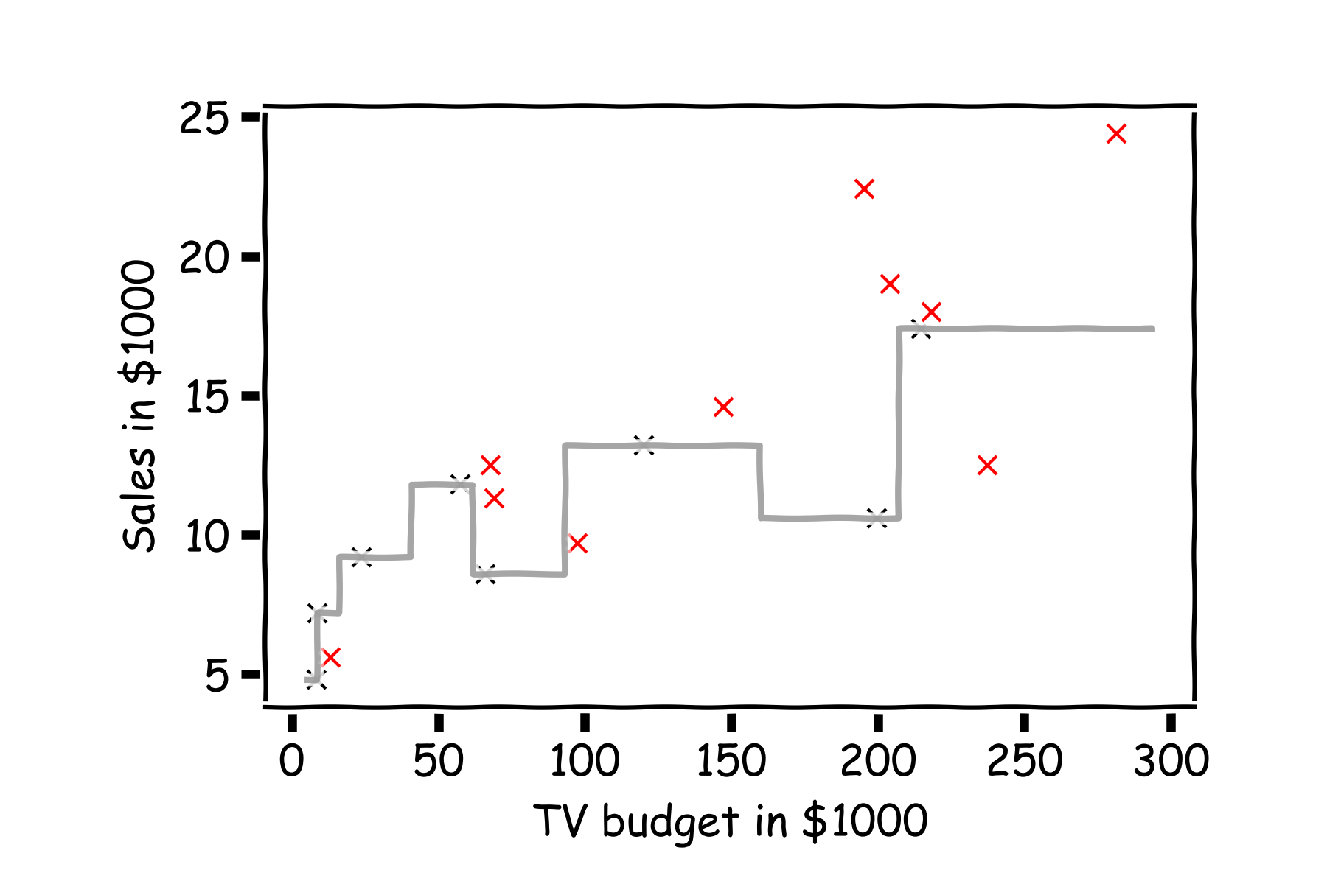
Error Evaluation
Now, we look at the data we have not used, the test data (red crosses).
Notes:
Change indeces and show k-nearest

Slide 72


Error Evaluation
Calculate the ${\text{residuals} (y}_{i}−{\hat{y}}_{i}).$
Notes:
Change indeces and show k-nearest

Slide 73

Error Evaluation
Do the same for k=3.
Notes:
Change indeces and show k-nearest

Slide 74

Error Evaluation
In order to quantify how well a model performs, we define a loss or error function.
A common loss function for quantitative outcomes is the Mean Squared Error (MSE):
The quantity $y_{i}−{\hat{y}}_{i}$ is called a residual and measures the error at the i-th prediction.
Notes:
Change indeces and show k-nearest

Slide 75
Error Evaluation
Caution: The MSE is by no means the only valid (or the best) loss function!
Question: What would be an intuitive loss function for predicting categorical outcomes?
Note: The square Root of the Mean of the Squared Errors (RMSE) is also commonly used.
Notes:
Change indeces and show k-nearest
Do you want to mention that RMSE isn’t always great b/c it’s not smooth? This would give them an idea on the things to consider when choosing loss functions. (DLS)

Slide 76

Things to Consider
Comparison of Two Models
How do we choose from two different models?
Model Fitness
How does the model perform predicting?
Evaluating Significance of Predictors
Does the outcome depend on the predictors?
How well do we know $\hat{f}$
The confidence intervals of our $\hat{f}$

Slide 77
Model Comparison

Slide 78

Model Comparison
Do the same for all k’s and compare the RMSEs. k=3 seems to be the best model.

Slide 79
Things to Consider
Comparison of Two Models
How do we choose from two different models?
Model Fitness
How does the model perform predicting?
Evaluating Significance of Predictors
Does the outcome depend on the predictors?
How well do we know $\hat{f}$
The confidence intervals of our $\hat{f}$

Slide 80
Model Fitness

Slide 81

Model fitness
For a subset of the data, calculate the RMSE for k=3. Is RMSE=5.0 good enough?

Slide 82

Model fitness
What if we measure the Sales in cents instead of dollars?
RMSE is now 5004.93.
Is that good?

Slide 83

Model fitness
It is better if we compare it to something.
We will use the simplest model:
Notes:
Change this to a nicer plot
The subscript on the summation should be i=1 for clarity. I can’t seem to change this either… (DLS)

Slide 84

R-squared
If our model is as good as the mean value, $\overline{y}$, then $R^{2}=0$
If our model is perfect then $R^{2}=1$
$R^{2}$ can be negative if the model is worst than the average. This can happen when we evaluate the model in the test set.
Notes:
Change this to a nicer plot

